Slide 1
MINAMATA CONVENTION ON MERCURY:
PRODUCTS, PROCESSES, AND EXEMPTIONS
Legal Assessment Training Module
Natural Resources Defense Council
February 2017
Notes:
This training module was produced by the Natural Resources Defense Council (NRDC), with the financial support of the United Nations Environmental Programme (UNEP). The module describes the relevant obligations of Parties under the Minamata Convention on Mercury, and the legal authorities which may be needed to implement those Convention obligations. It is intended to provide guidance to governments and others undertaking Minamata Convention on Mercury legal capacity assessments (as part of a Minamata Initial Assessment or otherwise). Practical advice regarding Convention preparation and implementation activities is also provided.

Slide 2
TRAINING MODULE CONTENTS
ARTICLE 4 AND ANNEX A (PRODUCTS)
  SECTION ONE: PRODUCT PHASE-OUTS
    Annex A Coverage, Key Points
    Effective Date of Phase-Out
    Exclusions from Phase-Out Mandate
    Product Components
    Dental Amalgam Phase-down
    New Products
    SECTION ONE SUMMARY: PRODUCT LEGAL AUTHORITIES
ARTICLE 5 AND ANNEX B (PROCESSES)
  SECTION TWO: MANUFACTURING PROCESS
  PHASE-OUTS
    Mercury at Chlor-Alkali Plants
    Restricted Mercury Uses In Manufacturing
    Key VCM Requirements
    Key Polyurethane Requirements
    Common Requirements For All Five Processes
    New Processes
    SECTION TWO SUMMARY: MANUFACTURING LEGAL AUTHORITIES
ARTICLE 6 (EXTENSION OF TIME)
  SECTION THREE: ARTICLE 6 EXEMPTION PROCESS
    Structure of Article 6
    When to Register for Initial Exemption
    How to Register
    Duration of Initial Exemption
PREPARATION FOR CONVENTION (MIA)
RESOURCES
Notes:
This training module covers the Convention obligations to reduce mercury use in products and manufacturing processes. It also covers the mechanism available to Parties that want additional time to comply with these obligations. These portions of the Convention are found in Articles 4-6, and Annexes A and B.
NRDC has produced two other training modules: (1) mercury supply and trade, and artisanal and small-scale gold mining (ASGM) (Articles 3 and 7 of the Convention); and (2) air emissions and releases to land and water (Articles 8 and 9 of the Convention).
Users of this module should have a copy of the Convention text readily available for easy reference during this training module. The Convention text can be found at http://www.mercuryconvention.org/Convention/tabid/3426/Default.aspx. A further description and explanation of the Convention text can be found in a Convention Manual co-authored by NRDC, available in English, French, and Spanish at https://www.nrdc.org/resources/minamata-convention-mercury-contents-guidance-and-resources.

Slide 3
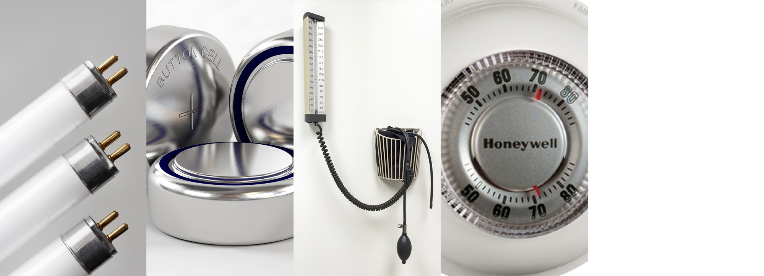
SECTION
ONE
PRODUCT PHASE-OUTS
ARTICLE 4 AND ANNEX A (PRODUCTS)
PRODUCT PHASE-OUTS
Annex A Coverage, Key Points
Effective Date of Phase-Out
Exclusions from Phase-Out Mandate
Product Components
Dental Amalgam Phase-down
New Products
Product Legal Authorities Summary
ARTICLE 5 AND ANNEX B (PROCESSES)
MANUFACTURING PROCESS PHASE-OUTS
Mercury at Chlor-Alkali Plants
Restricted Mercury Uses In Manufacturing
Key VCM Requirements
Key Polyurethane Requirements
Common Requirements For All Five Processes
New Processes
Manufacturing Legal Authorities Summary
ARTICLE 6 (EXTENSION OF TIME)
ARTICLE 6 EXEMPTION PROCESS
Structure of Article 6
When to Register for Initial Exemption
How to Register
Duration of Initial Exemption
PREPARATION FOR CONVENTION (MIA)
RESOURCES
Notes:
Under Article 4, the Convention will reduce mercury demand in products through a combination of measures which phase out mercury uses in many key products, phase down mercury use in dental amalgam, and discourage the manufacture of new products using mercury. Annex A, Part 1 of the Convention lists the mercury products subject to the Convention phase out obligations. These include many batteries, switches and relays, fluorescent lamps, cosmetics, pesticides, thermometers, blood pressure cuffs, and other measuring devices where mercury or a mercury compound is intentionally added to the product. The phase-out applies to the manufacture, import, and export of the selected products but it does not apply to their use. This means mercury-added products already in commerce can still be used within a country after the Convention phase-out date.
The Convention does provide an alternative compliance pathway under Article 4.2, but Parties that want to use this option will must demonstrate that they have already reduced to de minimis (very small) levels the manufacture, import and export of a large majority of the products listed in Part I of Annex A.

Slide 4
ANNEX A COVERAGE—KEY POINTS
ARTICLE 4 AND ANNEX A (PRODUCTS)
PRODUCT PHASE-OUTS
ANNEX A COVERAGE, KEY POINTS
Effective Date of Phase-Out
Exclusions from Phase-Out Mandate
Product Components
Dental Amalgam Phase-down
New Products
Product Legal Authorities Summary
ARTICLE 5 AND ANNEX B (PROCESSES)
MANUFACTURING PROCESS PHASE-OUTS
Mercury at Chlor-Alkali Plants
Restricted Mercury Uses In Manufacturing
Key VCM Requirements
Key Polyurethane Requirements
Common Requirements For All Five Processes
New Processes
Manufacturing Legal Authorities Summary
ARTICLE 6 (EXTENSION OF TIME)
ARTICLE 6 EXEMPTION PROCESS
Structure of Article 6
When to Register for Initial Exemption
How to Register
Duration of Initial Exemption
PREPARATION FOR CONVENTION (MIA)
RESOURCES
All batteries, except two kinds of button cells
Lamp phase-out mostly based on concentration limits
Key biocide product is paint
Cosmetics based on concentration limit associated with intentional mercury use
Notes:
The list of products in Annex A Part 1 is mostly straightforward, but some of the product listings deserve more explanation. For example, the Annex A, Part 1 list includes all batteries except the button cells typically used in hearing aids (zinc air) and watches (silver oxide). Mercury is sometimes used in these kinds of batteries for corrosion control, so the Convention allows for some mercury content, but the amount must be less than 2%. Most manufacturers already meet the 2% limit, or produce mercury free alternatives, so there should be few difficulties meeting this requirement.
Most lamp categories listed in Annex A have mercury content limits, so the phase out applies only to lamps exceeding the limits. One exception is high pressure mercury vapour lamps, which must be phased out entirely.
Annex A also phases out the use of mercury in pesticides, biocides and topical antiseptics. The mention of biocides covers one important use of mercury in paint. Large quantities of mercury were historically used in paint to prevent growth of bacteria during storage, and growth of algae/fungi after application of the paint.
Cosmetics such as skin lightening creams are covered as well, if mercury content is above 1 ppm. This concentration is intended to capture those cosmetics where mercury is intentionally added.

Slide 5
EFFECTIVE DATE OF PHASE-OUT
ARTICLE 4 AND ANNEX A (PRODUCTS)
PRODUCT PHASE-OUTS
Annex A Coverage, Key Points
EFFECTIVE DATE OF PHASE-OUT
Exclusions from Phase-Out Mandate
Product Components
Dental Amalgam Phase-down
New Products
Product Legal Authorities Summary
ARTICLE 5 AND ANNEX B (PROCESSES)
MANUFACTURING PROCESS PHASE-OUTS
Mercury at Chlor-Alkali Plants
Restricted Mercury Uses In Manufacturing
Key VCM Requirements
Key Polyurethane Requirements
Common Requirements For All Five Processes
New Processes
Manufacturing Legal Authorities Summary
ARTICLE 6 (EXTENSION OF TIME)
ARTICLE 6 EXEMPTION PROCESS
Structure of Article 6
When to Register for Initial Exemption
How to Register
Duration of Initial Exemption
PREPARATION FOR CONVENTION (MIA)
RESOURCES
Product phase-out date:*
2020
*UNLESS Party obtains extension of time under Article 6.
The Article 6 extension process is covered later in this training module.
Notes:
All the products listed in Annex A are subject to the same effective phase out date – 2020. Note the effective date is written as a calendar date. The date does not change depending on when governments become Parties to the Convention. As mentioned earlier, Article 6 contains a mechanism by which Parties can obtain an extension of time for the effective date. These extensions of time will be both country-specific and product-specific.

Slide 6

EXCLUSIONS FROM PHASE-OUT MANDATE
ARTICLE 4 AND ANNEX A (PRODUCTS)
PRODUCT PHASE-OUTS
Annex A Coverage, Key Points
Effective Date of Phase-Out
EXCLUSIONS FROM PHASE-OUT MANDATE
Product Components
Dental Amalgam Phase-down
New Products
Product Legal Authorities Summary
ARTICLE 5 AND ANNEX B (PROCESSES)
MANUFACTURING PROCESS PHASE-OUTS
Mercury at Chlor-Alkali Plants
Restricted Mercury Uses In Manufacturing
Key VCM Requirements
Key Polyurethane Requirements
Common Requirements For All Five Processes
New Processes
Manufacturing Legal Authorities Summary
ARTICLE 6 (EXTENSION OF TIME)
ARTICLE 6 EXEMPTION PROCESS
Structure of Article 6
When to Register for Initial Exemption
How to Register
Duration of Initial Exemption
PREPARATION FOR CONVENTION (MIA)
RESOURCES
“Essential” military/police use
R+D/calibration
Replacements
Vaccines
Traditional/religious practices
Notes:
Annex A begins with a list of products used in special circumstances that may be excluded from the phase-out requirements. Products may fall outside the phase-out mandate if any of the exclusions in this list apply. The list of exclusions includes “essential” military and civil protection (e.g., police) applications, but the term “essential” is undefined, so governments have some discretion to interpret its meaning. Most products used by both the military and ordinary consumers may not be essential, given the availability of non-mercury alternatives (or in the case of lamps lower mercury alternatives) that perform the identical function. However, there may be unique types of products in these categories, such as special switches used on submarines or satellites, where the mercury is needed because of the high stress application in which it functions.
Other exclusions potentially apply for research or replacement purposes. Measuring devices, such as blood pressure cuffs, may be an example where a small number of units may still be needed for use in research or calibration activities. Regarding replacements, there may be instances where non-mercury switches, relays or measuring devices, or lower mercury lamps of certain types, are unavailable as replacement components in larger equipment or machinery. The classic example is a mercury switch made for a complex and expensive piece of manufacturing equipment, and the only switch made for this equipment is a mercury switch. This exclusion would allow manufacture or trade of a new replacement mercury switch so that the expensive equipment can continue to be used. Governments may consider how they will determine the availability of non-mercury replacements if and when these situations are encountered.
There is an exclusion potentially available for traditional or religious practices, but the products currently listed in Annex A are not often used in this way. Lastly, the Convention exempts vaccines from regulation to maintain the availability of vaccines using mercury as a preservative, particularly where refrigeration is unavailable in the developing world.

Slide 7
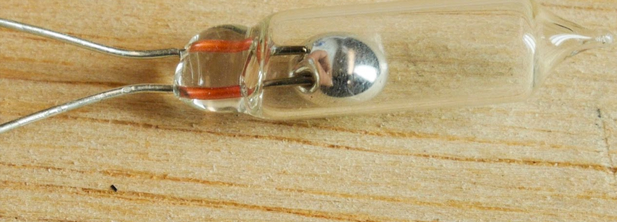
PRODUCT COMPONENTS
ARTICLE 4 AND ANNEX A (PRODUCTS)
PRODUCT PHASE-OUTS
Annex A Coverage, Key Points
Effective Date of Phase-Out
Exclusions from Phase-Out Mandate
PRODUCT COMPONENTS
Dental Amalgam Phase-down
New Products
Product Legal Authorities Summary
ARTICLE 5 AND ANNEX B (PROCESSES)
MANUFACTURING PROCESS PHASE-OUTS
Mercury at Chlor-Alkali Plants
Restricted Mercury Uses In Manufacturing
Key VCM Requirements
Key Polyurethane Requirements
Common Requirements For All Five Processes
New Processes
Manufacturing Legal Authorities Summary
ARTICLE 6 (EXTENSION OF TIME)
ARTICLE 6 EXEMPTION PROCESS
Structure of Article 6
When to Register for Initial Exemption
How to Register
Duration of Initial Exemption
PREPARATION FOR CONVENTION (MIA)
RESOURCES
What if phased out product is part of a larger product (e.g., a switch, lamp,
battery, etc., in electronic device)?
Obligation to prevent incorporation into larger product
Notes:
Switches and relays are often components of larger products. Under Paragraph 5 of Article 4, a Party must take measures to prevent mercury-added switches and relays from being incorporated into larger products. It is the responsibility of Parties who are manufacturing larger products to verify that any components used are allowed under Annex A, either through their import controls or controls on the manufacturer. Similar issues may arise with respect to batteries and lamps identified for phase-out in Annex A.

Slide 8
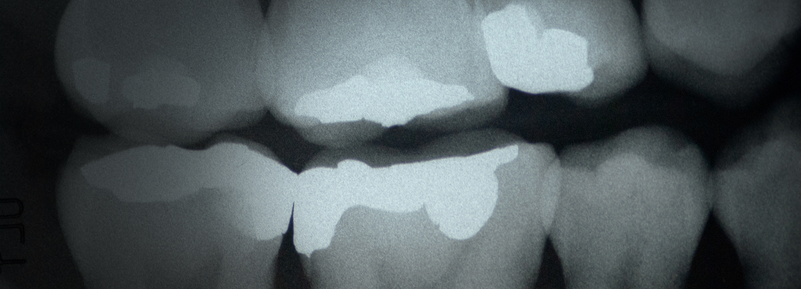
DENTAL AMALGAM PHASE-DOWN
ARTICLE 4 AND ANNEX A (PRODUCTS)
PRODUCT PHASE-OUTS
Annex A Coverage, Key Points
Effective Date of Phase-Out
Exclusions from Phase-Out Mandate
Product Components
DENTAL AMALGAM PHASE-DOWN
New Products
Product Legal Authorities Summary
ARTICLE 5 AND ANNEX B (PROCESSES)
MANUFACTURING PROCESS PHASE-OUTS
Mercury at Chlor-Alkali Plants
Restricted Mercury Uses In Manufacturing
Key VCM Requirements
Key Polyurethane Requirements
Common Requirements For All Five Processes
New Processes
Manufacturing Legal Authorities Summary
ARTICLE 6 (EXTENSION OF TIME)
ARTICLE 6 EXEMPTION PROCESS
Structure of Article 6
When to Register for Initial Exemption
How to Register
Duration of Initial Exemption
PREPARATION FOR CONVENTION (MIA)
RESOURCES
Nine options provided in Annex A, Part II
Choose at least two
Authorities needed depends upon choices
Notes:
Annex A, Part II focuses on the obligation to phase down (rather than phase out) the use of mercury in dental amalgam. The Annex lists nine potential options that Parties can take to implement this phase down. The legal authorities which may be required to implement these options vary widely depending upon the option. For example, several options involve dental insurance, one option restricts the use of mercury to its encapsulated form, and another option targets best environmental practices in dental offices (typically requiring amalgam separators to minimize mercury discharges into wastewaters). Accordingly, governments should consider the phase down options they wish to pursue, and then the authorities needed to implement the options chosen. In some cases, such as the promotion of research and development, or education and training of mercury-free dentistry, new legal authorities may not be needed.

Slide 9

NEW PRODUCTS
ARTICLE 4 AND ANNEX A (PRODUCTS)
PRODUCT PHASE-OUTS
Annex A Coverage, Key Points
Effective Date of Phase-Out
Exclusions from Phase-Out Mandate
Product Components
Dental Amalgam Phase-down
NEW PRODUCTS
Product Legal Authorities Summary
ARTICLE 5 AND ANNEX B (PROCESSES)
MANUFACTURING PROCESS PHASE-OUTS
Mercury at Chlor-Alkali Plants
Restricted Mercury Uses In Manufacturing
Key VCM Requirements
Key Polyurethane Requirements
Common Requirements For All Five Processes
New Processes
Manufacturing Legal Authorities Summary
ARTICLE 6 (EXTENSION OF TIME)
ARTICLE 6 EXEMPTION PROCESS
Structure of Article 6
When to Register for Initial Exemption
How to Register
Duration of Initial Exemption
PREPARATION FOR CONVENTION (MIA)
RESOURCES
“Discourage” previously unknown products
“Discourage” undefined
Notes:
The Convention requires that each Party “discourage” mercury use in product types not previously known to that Party when the Convention entered into force for it. This may require an understanding of existing uses of mercury in products within the country, and a way to address any new uses which may arise. Legal authorities may be needed to collect information on existing uses, and to address new uses. Parties may choose to use authorities to restrict or prohibit new manufacturing processes using mercury, perhaps with exemptions available for extraordinary situations, to meet this Convention obligation.

Slide 10

SECTION ONE SUMMARY:
PRODUCT LEGAL AUTHORITIES
ARTICLE 4 AND ANNEX A (PRODUCTS)
PRODUCT PHASE-OUTS
Annex A Coverage, Key Points
Effective Date of Phase-Out
Exclusions from Phase-Out Mandate
Product Components
Dental Amalgam Phase-down
New Products
PRODUCT LEGAL AUTHORITIES SUMMARY
ARTICLE 5 AND ANNEX B (PROCESSES)
MANUFACTURING PROCESS PHASE-OUTS
Mercury at Chlor-Alkali Plants
Restricted Mercury Uses In Manufacturing
Key VCM Requirements
Key Polyurethane Requirements
Common Requirements For All Five Processes
New Processes
Manufacturing Legal Authorities Summary
ARTICLE 6 (EXTENSION OF TIME)
ARTICLE 6 EXEMPTION PROCESS
Structure of Article 6
When to Register for Initial Exemption
How to Register
Duration of Initial Exemption
PREPARATION FOR CONVENTION (MIA)
RESOURCES
No manufacture, import, or export of phased out products after 2020
Dental amalgam phase down measures
Prevent mercury components going into larger products
Discourage mercury-added products previously unknown
☑
☑
☑
☑
Notes:
The legal authorities necessary to implement Article 4 may be found in multiple sources, such as the Party’s environmental law, hazardous substances control law, and the law(s) governing the import, safety, licensing and distribution of medical products and cosmetics. The authorities used to implement the Montreal Protocol or the Stockholm Convention should be reviewed for their applicability to mercury-added products. The dental amalgam phase down measures may also involve insurance, medical device licensing, and waste management/water pollution laws, depending upon the phase down measures chosen by the government.

Slide 11
SECTION
TWO
MANUFACTURING PROCESS PHASE-OUTS
ARTICLE 4 AND ANNEX A (PRODUCTS)
PRODUCT PHASE-OUTS
Annex A Coverage, Key Points
Effective Date of Phase-Out
Exclusions from Phase-Out Mandate
Product Components
Dental Amalgam Phase-down
New Products
Product Legal Authorities Summary
ARTICLE 5 AND ANNEX B (PROCESSES)
MANUFACTURING PROCESS PHASE-OUTS
Mercury at Chlor-Alkali Plants
Restricted Mercury Uses In Manufacturing
Key VCM Requirements
Key Polyurethane Requirements
Common Requirements For All Five Processes
New Processes
Manufacturing Legal Authorities Summary
ARTICLE 6 (EXTENSION OF TIME)
ARTICLE 6 EXEMPTION PROCESS
Structure of Article 6
When to Register for Initial Exemption
How to Register
Duration of Initial Exemption
PREPARATION FOR CONVENTION (MIA)
RESOURCES
Manufacturing phase-out dates:
2018
2025
ACETYLENE PRODUCTION:
CHLOR-ALKALI PLANTS:
Notes:
Article 5 of the Convention will reduce mercury demand in the manufacturing sector, using approaches similar to those used for products under Article 4. The Convention will phase out mercury uses in two manufacturing processes, restrict mercury use in three other processes, and discourage mercury use in new manufacturing processes.
Annex B of the Convention lists the processes covered by Article 5. Part 1 of Annex B specifies the two manufacturing processes subject to the phase-out requirements: acetylene manufacturing and mercury-cell chlor-alkali manufacturing. The acetylene production process must be phased out by 2018, which is coming soon, but compliance should not be a problem since there are no factories in the world using mercury to produce acetylene, according to experts involved in the negotiations. Some chlor-alkali manufacturing plants produce chlorine and caustic soda from brine using mercury to conduct an electric current which separates the salt into chlorine and sodium. Mercury use in chlor-alkali production must be phased out by 2025, unless an extension of time is obtained under Article 6.

Slide 12
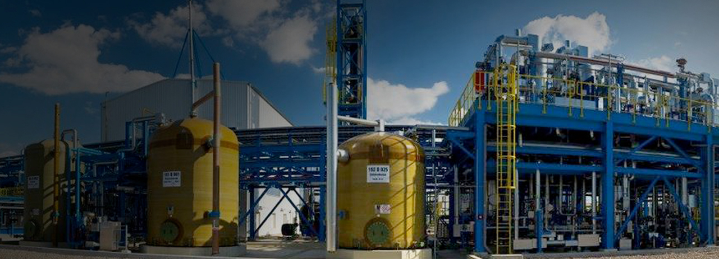
MERCURY AT CHLOR-ALKALI PLANTS
ARTICLE 4 AND ANNEX A (PRODUCTS)
PRODUCT PHASE-OUTS
Annex A Coverage, Key Points
Effective Date of Phase-Out
Exclusions from Phase-Out Mandate
Product Components
Dental Amalgam Phase-down
New Products
Product Legal Authorities Summary
ARTICLE 5 AND ANNEX B (PROCESSES)
MANUFACTURING PROCESS PHASE-OUTS
MERCURY AT CHLOR-ALKALI PLANTS
Restricted Mercury Uses In Manufacturing
Key VCM Requirements
Key Polyurethane Requirements
Common Requirements For All Five Processes
New Processes
Manufacturing Legal Authorities Summary
ARTICLE 6 (EXTENSION OF TIME)
ARTICLE 6 EXEMPTION PROCESS
Structure of Article 6
When to Register for Initial Exemption
How to Register
Duration of Initial Exemption
PREPARATION FOR CONVENTION (MIA)
RESOURCES
Identification of large mercury stocks (Article 3)
Safe storage (Article 10)
Severe restriction on reuse at decommissioning (Article 3)
Notes:
Large quantities of mercury often used and stored at operating mercury cell chlor-alkali facilities are also governed by other parts of the Convention. The other training modules, and the resources identified in slide two of this training module, provide detailed descriptions of these related obligations. For an inventory of global chlor-alkali plants using mercury (available in the 6 UN languages), see http://web.unep.org/chemicalsandwaste/global-mercury-partnership/mercury-reduction-chlor-alkali-sector/reports-and-publications.

Slide 13

RESTRICTED MERCURY USES IN MANUFACTURING
ARTICLE 4 AND ANNEX A (PRODUCTS)
PRODUCT PHASE-OUTS
Annex A Coverage, Key Points
Effective Date of Phase-Out
Exclusions from Phase-Out Mandate
Product Components
Dental Amalgam Phase-down
New Products
Product Legal Authorities Summary
ARTICLE 5 AND ANNEX B (PROCESSES)
MANUFACTURING PROCESS PHASE-OUTS
Mercury at Chlor-Alkali Plants
RESTRICTED MERCURY USES
IN MANUFACTURING
Key VCM Requirements
Key Polyurethane Requirements
Common Requirements For All Five Processes
New Processes
Manufacturing Legal Authorities Summary
ARTICLE 6 (EXTENSION OF TIME)
ARTICLE 6 EXEMPTION PROCESS
Structure of Article 6
When to Register for Initial Exemption
How to Register
Duration of Initial Exemption
PREPARATION FOR CONVENTION (MIA)
RESOURCES
Vinyl chloride monomer (VCM)
Biodiesels
Polyurethane
Notes:
Part II of Annex B contains the restrictions on mercury used as a catalyst in three other manufacturing processes. One of these processes is the manufacturing of sodium or potassium methylate or ethylate chemicals that are used in making some biodiesels. Only two German factories are known to use mercury catalysts for this purpose, therefore this training module will not address the particular restrictions specified in Annex B for this process.

Slide 14
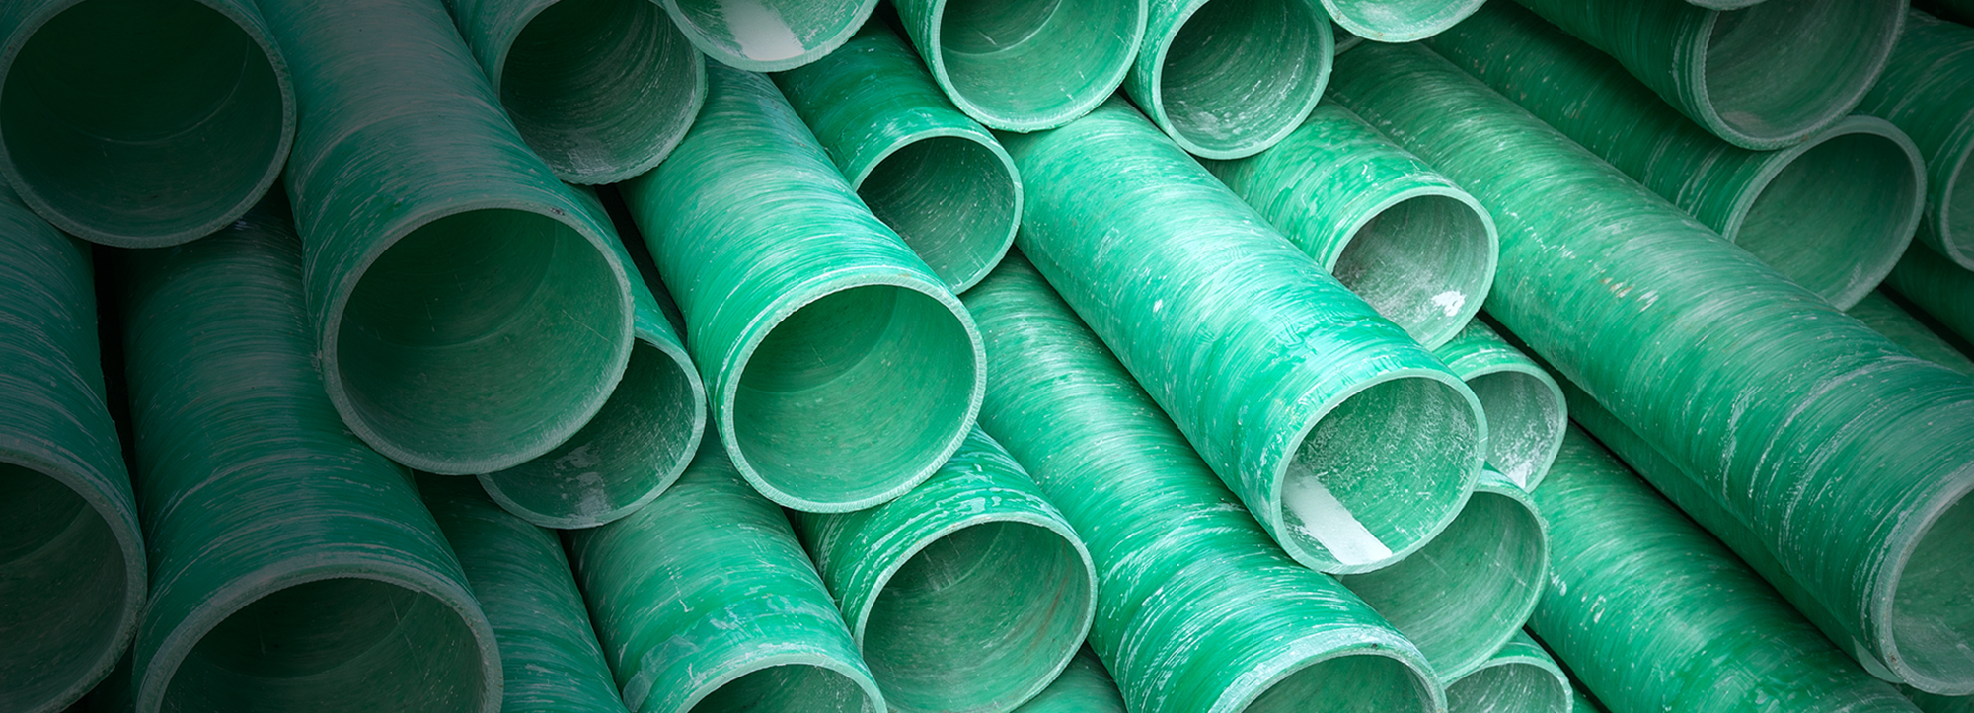
KEY VCM REQUIREMENTS
ARTICLE 4 AND ANNEX A (PRODUCTS)
PRODUCT PHASE-OUTS
Annex A Coverage, Key Points
Effective Date of Phase-Out
Exclusions from Phase-Out Mandate
Product Components
Dental Amalgam Phase-down
New Products
Product Legal Authorities Summary
ARTICLE 5 AND ANNEX B (PROCESSES)
MANUFACTURING PROCESS PHASE-OUTS
Mercury at Chlor-Alkali Plants
Restricted Mercury Uses In Manufacturing
KEY VCM REQUIREMENTS
Key Polyurethane Requirements
Common Requirements For All Five Processes
New Processes
Manufacturing Legal Authorities Summary
ARTICLE 6 (EXTENSION OF TIME)
ARTICLE 6 EXEMPTION PROCESS
Structure of Article 6
When to Register for Initial Exemption
How to Register
Duration of Initial Exemption
PREPARATION FOR CONVENTION (MIA)
RESOURCES
50% reduction in mercury use by 2020
Reduced reliance on primary mercury mining
Phase out in five years after COP action
Notes:
In a few countries, mainly China, a mercury-based catalyst is used to make vinyl chloride monomer (VCM) from a coal-based feedstock. The VCM is then used to make polyvinyl chloride (PVC), a polymer used to make plastic.
In the short-term, mercury use in VCM production must be reduced by half by 2020, based upon per unit production in 2010. A Party must also “promote” measures to reduce reliance on primary mercury mining in VCM production, presumably reflecting this reduced mercury consumption and efficiencies which may be gained through improved catalyst recycling. Once the COP determines mercury free catalysts for the coal-based process are available, Parties must phase out this mercury use within five years.

Slide 15

KEY POLYURETHANE REQUIREMENTS
ARTICLE 4 AND ANNEX A (PRODUCTS)
PRODUCT PHASE-OUTS
Annex A Coverage, Key Points
Effective Date of Phase-Out
Exclusions from Phase-Out Mandate
Product Components
Dental Amalgam Phase-down
New Products
Product Legal Authorities Summary
ARTICLE 5 AND ANNEX B (PROCESSES)
MANUFACTURING PROCESS PHASE-OUTS
Mercury at Chlor-Alkali Plants
Restricted Mercury Uses In Manufacturing
Key VCM Requirements
KEY POLYURETHANE REQUIREMENTS
Common Requirements For All Five Processes
New Processes
Manufacturing Legal Authorities Summary
ARTICLE 6 (EXTENSION OF TIME)
ARTICLE 6 EXEMPTION PROCESS
Structure of Article 6
When to Register for Initial Exemption
How to Register
Duration of Initial Exemption
PREPARATION FOR CONVENTION (MIA)
RESOURCES
“Aim” for phase out in 10 years
Reduce reliance on primary mercury mining
Notes:
Besides VCM, mercury catalysts are used in a small but unknown percentage of polyurethane manufacturing globally. Under Annex B, the goal is to “phase out this use as soon as possible” within 10 years. As written, this is a non-binding obligation, but it is a Convention objective that a Party should bear in mind as it develops authorities to regulate this manufacturing process.

Slide 16
COMMON REQUIREMENTS FOR ALL FIVE PROCESSES
ARTICLE 4 AND ANNEX A (PRODUCTS)
PRODUCT PHASE-OUTS
Annex A Coverage, Key Points
Effective Date of Phase-Out
Exclusions from Phase-Out Mandate
Product Components
Dental Amalgam Phase-down
New Products
Product Legal Authorities Summary
ARTICLE 5 AND ANNEX B (PROCESSES)
MANUFACTURING PROCESS PHASE-OUTS
Mercury at Chlor-Alkali Plants
Restricted Mercury Uses In Manufacturing
Key VCM Requirements
Key Polyurethane Requirements
COMMON REQUIREMENTS FOR ALL
FIVE PROCESSES
New Processes
Manufacturing Legal Authorities Summary
ARTICLE 6 (EXTENSION OF TIME)
ARTICLE 6 EXEMPTION PROCESS
Structure of Article 6
When to Register for Initial Exemption
How to Register
Duration of Initial Exemption
PREPARATION FOR CONVENTION (MIA)
RESOURCES
Emissions/Releases Control
Identify number, types, mercury
No new facilities (except polyurethane?)
Notes:
Paragraph 5 of Article 5 contains obligations for Parties to address mercury air emissions, and releases to land and water, from facilities in all the Annex B source categories, including but not limited to fugitive emissions which may be significant at some of these facilities. Parties must also “endeavor” to identify the regulated facilities, and obtain data on the number and types of facilities, and estimated amount of mercury consumed at these facilities annually. Parties will be requested to report the information to the Secretariat.
The phase outs and restrictions previously described apply to existing manufacturing plants. Paragraph 6 of Article 5 essentially bans the construction of any new manufacturing plants of the type listed in Annex B. As a technical matter, Annex B, Part II, excludes facilities used to produce polyurethane from this new construction ban, but then also aims to phase out this use within 10 years of entry into force of the Convention.
Note the exemption processes in Article 6 do not apply to the prohibition against new manufacturing facilities. That is, there are no extensions of time for this ban on new facilities.

Slide 17
NEW PROCESSES
ARTICLE 4 AND ANNEX A (PRODUCTS)
PRODUCT PHASE-OUTS
Annex A Coverage, Key Points
Effective Date of Phase-Out
Exclusions from Phase-Out Mandate
Product Components
Dental Amalgam Phase-down
New Products
Product Legal Authorities Summary
ARTICLE 5 AND ANNEX B (PROCESSES)
MANUFACTURING PROCESS PHASE-OUTS
Mercury at Chlor-Alkali Plants
Restricted Mercury Uses In Manufacturing
Key VCM Requirements
Key Polyurethane Requirements
Common Requirements For All Five Processes
NEW PROCESSES
Manufacturing Legal Authorities Summary
ARTICLE 6 (EXTENSION OF TIME)
ARTICLE 6 EXEMPTION PROCESS
Structure of Article 6
When to Register for Initial Exemption
How to Register
Duration of Initial Exemption
PREPARATION FOR CONVENTION (MIA)
RESOURCES
“Discourage” new uses in manufacturing
COP approval required for new uses
Notes:
The Convention requires that each Party “discourage” mercury uses in manufacturing (other than the five listed in Annex B) that did not exist before the Convention entered into force. As in Article 4 for products, the term “discourage” is undefined, but in this case, COP approval is required for the new manufacturing process. Parties may choose to use authorities to restrict or prohibit new manufacturing processes using mercury, perhaps with exemptions available for extraordinary situations, to meet this Convention obligation.

Slide 18
SECTION TWO SUMMARY:
MANUFACTURING LEGAL AUTHORITIES
ARTICLE 4 AND ANNEX A (PRODUCTS)
PRODUCT PHASE-OUTS
Annex A Coverage, Key Points
Effective Date of Phase-Out
Exclusions from Phase-Out Mandate
Product Components
Dental Amalgam Phase-down
New Products
Product Legal Authorities Summary
ARTICLE 5 AND ANNEX B (PROCESSES)
MANUFACTURING PROCESS PHASE-OUTS
Mercury at Chlor-Alkali Plants
Restricted Mercury Uses In Manufacturing
Key VCM Requirements
Key Polyurethane Requirements
Common Requirements For All Five Processes
New Processes
MANUFACTURING LEGAL AUTHORITIES
SUMMARY
ARTICLE 6 (EXTENSION OF TIME)
ARTICLE 6 EXEMPTION PROCESS
Structure of Article 6
When to Register for Initial Exemption
How to Register
Duration of Initial Exemption
PREPARATION FOR CONVENTION (MIA)
RESOURCES
☑
Phase out for acetylene (2018) and chlor-alkali (2025)
Restrictions for three other processes
Not allow new facilities
Identify facilities, obtain information on mercury use, control
mercury emissions to air and releases to land and water
Discourage new industrial processes
☑
☑
☑
☑
Notes:
Legal authorities to implement these Convention obligations may be found in a nation’s environmental law, hazardous substances control law, and air/water pollution control laws. Release reporting or pollution registry laws may provide the authority to require reporting on mercury use and releases. The authorities used to implement the Montreal Protocol or the Stockholm Convention should be reviewed for their applicability to these industrial processes.

Slide 19

ARTICLE 6 EXEMPTION PROCESS
ARTICLE 4 AND ANNEX A (PRODUCTS)
PRODUCT PHASE-OUTS
Annex A Coverage, Key Points
Effective Date of Phase-Out
Exclusions from Phase-Out Mandate
Product Components
Dental Amalgam Phase-down
New Products
Product Legal Authorities Summary
ARTICLE 5 AND ANNEX B (PROCESSES)
MANUFACTURING PROCESS PHASE-OUTS
Mercury at Chlor-Alkali Plants
Restricted Mercury Uses In Manufacturing
Key VCM Requirements
Key Polyurethane Requirements
Common Requirements For All Five Processes
New Processes
Manufacturing Legal Authorities Summary
ARTICLE 6 (EXTENSION OF TIME)
ARTICLE 6 EXEMPTION PROCESS
Structure of Article 6
When to Register for Initial Exemption
How to Register
Duration of Initial Exemption
PREPARATION FOR CONVENTION (MIA)
RESOURCES
SECTION
THREE
Limited to products/processes
Only extension of time provided
Notes:
Article 6 provides a mechanism for Parties to receive more time to meet their obligations under Article 4 or Article 5, or both Note the exemption is only a limited extension of time for compliance: it is not an exemption from complying at all. And these time exemptions are available only to the product and manufacturing process provisions of the Convention. There are no exemptions or extensions of time available for other Convention obligations, such as the supply and trade or emissions control requirements.

Slide 20
STRUCTURE OF ARTICLE 6
ARTICLE 4 AND ANNEX A (PRODUCTS)
PRODUCT PHASE-OUTS
Annex A Coverage, Key Points
Effective Date of Phase-Out
Exclusions from Phase-Out Mandate
Product Components
Dental Amalgam Phase-down
New Products
Product Legal Authorities Summary
ARTICLE 5 AND ANNEX B (PROCESSES)
MANUFACTURING PROCESS PHASE-OUTS
Mercury at Chlor-Alkali Plants
Restricted Mercury Uses In Manufacturing
Key VCM Requirements
Key Polyurethane Requirements
Common Requirements For All Five Processes
New Processes
Manufacturing Legal Authorities Summary
ARTICLE 6 (EXTENSION OF TIME)
ARTICLE 6 EXEMPTION PROCESS
STRUCTURE OF ARTICLE 6
When to Register for Initial Exemption
How to Register
Duration of Initial Exemption
PREPARATION FOR CONVENTION (MIA)
RESOURCES
Two separate processes
Each provides up to five years
First is registration
Second requires COP approval
Notes:
Article 6 contains two separate processes for an extension of time. The first is a simplified registration process, which can provide an extension of time until 2025 for products, and 2030 for chlor-alkali facilities. This exemption expires at the end of the initial period. The second extension requires COP approval, and could potentially provide an extension until 2030 for products, and 2035 for chlor-alkali facilities, upon request by a Party. No extensions of time are available beyond these dates, regardless of when a country becomes a Party. Given the second process is many years away, this training module will focus on the initial registration process.

Slide 21
WHEN TO REGISTER FOR INITIAL EXEMPTION
ARTICLE 4 AND ANNEX A (PRODUCTS)
PRODUCT PHASE-OUTS
Annex A Coverage, Key Points
Effective Date of Phase-Out
Exclusions from Phase-Out Mandate
Product Components
Dental Amalgam Phase-down
New Products
Product Legal Authorities Summary
ARTICLE 5 AND ANNEX B (PROCESSES)
MANUFACTURING PROCESS PHASE-OUTS
Mercury at Chlor-Alkali Plants
Restricted Mercury Uses In Manufacturing
Key VCM Requirements
Key Polyurethane Requirements
Common Requirements For All Five Processes
New Processes
Manufacturing Legal Authorities Summary
ARTICLE 6 (EXTENSION OF TIME)
ARTICLE 6 EXEMPTION PROCESS
Structure of Article 6
WHEN TO REGISTER FOR INITIAL EXEMPTION
How to Register
Duration of Initial Exemption
PREPARATION FOR CONVENTION (MIA)
RESOURCES
When a government must register for the initial exemption depends on when it becomes a Party to the Convention, so it is critical to know when your government becomes a Party.
FIRST 50
GOVERNMENTS
BECOME PARTIES
&
CONVENTION
ENTERS INTO
FORCE
90
DAYS
TIMELINE FOR THE FIRST 50 GOVERNMENTS
Governments deposit their ratification documentation with Secretary General of the UN…
When the 50th government deposits its ratification documentation, it triggers a 90-day period…
THE FIRST 50 GOVERNMENTS MUST REGISTER FOR AN EXEMPTION BEFORE OR DURING THIS
90-DAY PERIOD.
Governments ratify the Convention in their home countries…
THE EXEMPTION REGISTRATION PERIOD FOR THE FIRST 50 GOVERNMENTS EXPIRES AT THIS TIME.
Notes:
When a Party must register for the initial exemption will depend upon when it becomes a Party to the Convention. For the first 50 governments ratifying the Convention and thereby triggering the Convention entering into force, they become Parties when the Convention enters into force, which is on the 90th day after the 50th government deposits its ratification documentation. Therefore, the first 50 governments must register for an exemption prior to this 90th day (which will be before COP 1). For other governments, they become Parties 90 days after they submit their ratification documentation, so their registrations are required before this time.

Slide 22
WHEN TO REGISTER FOR INITIAL EXEMPTION
ARTICLE 4 AND ANNEX A (PRODUCTS)
PRODUCT PHASE-OUTS
Annex A Coverage, Key Points
Effective Date of Phase-Out
Exclusions from Phase-Out Mandate
Product Components
Dental Amalgam Phase-down
New Products
Product Legal Authorities Summary
ARTICLE 5 AND ANNEX B (PROCESSES)
MANUFACTURING PROCESS PHASE-OUTS
Mercury at Chlor-Alkali Plants
Restricted Mercury Uses In Manufacturing
Key VCM Requirements
Key Polyurethane Requirements
Common Requirements For All Five Processes
New Processes
Manufacturing Legal Authorities Summary
ARTICLE 6 (EXTENSION OF TIME)
ARTICLE 6 EXEMPTION PROCESS
Structure of Article 6
WHEN TO REGISTER FOR INITIAL EXEMPTION
How to Register
Duration of Initial Exemption
PREPARATION FOR CONVENTION (MIA)
RESOURCES
Governments 51 and later become Parties 90 days after they deposit their individual ratification documents.
THE GOVERNMENT
BECOMES A PARTY
90
DAYS
TIMELINE FOR GOVERNMENTS 51 AND LATER
The government deposits its ratification documentation with Secretary General of the UN…
THE GOVERNMENT MUST REGISTER FOR AN EXEMPTION BEFORE OR DURING THE SUBSEQUENT
90-DAY PERIOD.
THE EXEMPTION REGISTRATION PERIOD FOR THE GOVERNMENT EXPIRES AFTER THE 90-DAY PERIOD ENDS.
A government ratifies the Convention in its home country…
Notes:
When a Party must register for the initial exemption will depend upon when it becomes a Party to the Convention. For the first 50 governments ratifying the Convention and thereby triggering the Convention entering into force, they become Parties when the Convention enters into force, which is on the 90th day after the 50th government deposits its ratification documentation. Therefore, the first 50 governments must register for an exemption prior to this 90th day (which will be before COP 1). For other governments, they become Parties 90 days after they submit their ratification documentation, so their registrations are required before this time.

Slide 23

HOW TO REGISTER
ARTICLE 4 AND ANNEX A (PRODUCTS)
PRODUCT PHASE-OUTS
Annex A Coverage, Key Points
Effective Date of Phase-Out
Exclusions from Phase-Out Mandate
Product Components
Dental Amalgam Phase-down
New Products
Product Legal Authorities Summary
ARTICLE 5 AND ANNEX B (PROCESSES)
MANUFACTURING PROCESS PHASE-OUTS
Mercury at Chlor-Alkali Plants
Restricted Mercury Uses In Manufacturing
Key VCM Requirements
Key Polyurethane Requirements
Common Requirements For All Five Processes
New Processes
Manufacturing Legal Authorities Summary
ARTICLE 6 (EXTENSION OF TIME)
ARTICLE 6 EXEMPTION PROCESS
Structure of Article 6
When to Register for Initial Exemption
HOW TO REGISTER
Duration of Initial Exemption
PREPARATION FOR CONVENTION (MIA)
RESOURCES
Use forms provided by Secretariat
Specificity requested as to product category,
and products within that category
Public listing of registrations created
Notes:
Forms for notifying the Secretariat were agreed at INC 6. The forms can be found at https://www.nrdc.org/sites/default/files/int_14120401b.pdf. On the form, the Party will specify both the product or process category or subcategory in Annex A or B for which they are requesting an exemption. The registration must be accompanied by a statement explaining the Party’s need for an exemption. The format for the public registry can also be found at the same website link.

Slide 24





DURATION OF INITIAL EXEMPTION
ARTICLE 4 AND ANNEX A (PRODUCTS)
PRODUCT PHASE-OUTS
Annex A Coverage, Key Points
Effective Date of Phase-Out
Exclusions from Phase-Out Mandate
Product Components
Dental Amalgam Phase-down
New Products
Product Legal Authorities Summary
ARTICLE 5 AND ANNEX B (PROCESSES)
MANUFACTURING PROCESS PHASE-OUTS
Mercury at Chlor-Alkali Plants
Restricted Mercury Uses In Manufacturing
Key VCM Requirements
Key Polyurethane Requirements
Common Requirements For All Five Processes
New Processes
Manufacturing Legal Authorities Summary
ARTICLE 6 (EXTENSION OF TIME)
ARTICLE 6 EXEMPTION PROCESS
Structure of Article 6
When to Register for Initial Exemption
How to Register
DURATION OF INITIAL EXEMPTION
PREPARATION FOR CONVENTION (MIA)
RESOURCES
Duration of initial exemption is up to five years. (Parties may register for shorter extensions.)
All product-related initial exemptions expire by 2025, regardless of when a government became a Party. (For this reason, extensions are shorter for post-2020 Parties.)
ALL PRODUCT-RELATED
EXEMPTIONS END:
2025
All chlor-alkali initial exemptions expire by 2030, regardless of when a government became a Party. (For this reason, extensions are shorter for post-2025 Parties.)
ALL CHLOR-ALKALI
EXEMPTIONS END:
2030
Notes:
The duration of the initial exemption depends on two factors: (1) When a government becomes a Party, and (2) Whether the Party requests an exemption for less than five years. For countries becoming Parties after 2020, the product-related registration exemption expires in 2025. The same date applies to all Parties, regardless of when they became a Party. Article 6 was drafted in this way, so that all the initial exemptions would be terminated by 2025 at the latest. Parties can also request a duration shorter than five years, for one or more product categories covered by the registration.
The same conceptual framework applies to manufacturing processes, with post-2025 Parties receiving a shorter initial registration extension of time for chlor-alkali plants.

Slide 25
PREPARATION FOR CONVENTION (MIA)
ARTICLE 4 AND ANNEX A (PRODUCTS)
PRODUCT PHASE-OUTS
Annex A Coverage, Key Points
Effective Date of Phase-Out
Exclusions from Phase-Out Mandate
Product Components
Dental Amalgam Phase-down
New Products
Product Legal Authorities Summary
ARTICLE 5 AND ANNEX B (PROCESSES)
MANUFACTURING PROCESS PHASE-OUTS
Mercury at Chlor-Alkali Plants
Restricted Mercury Uses In Manufacturing
Key VCM Requirements
Key Polyurethane Requirements
Common Requirements For All Five Processes
New Processes
Manufacturing Legal Authorities Summary
ARTICLE 6 (EXTENSION OF TIME)
ARTICLE 6 EXEMPTION PROCESS
Structure of Article 6
When to Register for Initial Exemption
How to Register
Duration of Initial Exemption
PREPARATION FOR CONVENTION (MIA)
RESOURCES
Inventory
Stakeholder outreach
Alternatives assessment
Legal capacity assessment
Ministry coordination
Notes:
Timely preparation is required to determine if an initial registration exemption should be submitted by a Party. This preparation may include an inventory of mercury products and manufacturing processes in the country; an assessment of when mercury free products (and products meeting applicable content limits), and mercury free manufacturing processes, can be available in the country; legal and policy authorities needed to implement the Convention obligations and otherwise promote mercury free alternatives; and coordination among ministries as to allocations of responsibility both for authority development and implementation (including enforcement). Outreach to stakeholders and civil society as part of these activities may provide useful information and increase awareness of the Convention and its objectives.

Slide 26

RESOURCES
ARTICLE 4 AND ANNEX A (PRODUCTS)
PRODUCT PHASE-OUTS
Annex A Coverage, Key Points
Effective Date of Phase-Out
Exclusions from Phase-Out Mandate
Product Components
Dental Amalgam Phase-down
New Products
Product Legal Authorities Summary
ARTICLE 5 AND ANNEX B (PROCESSES)
MANUFACTURING PROCESS PHASE-OUTS
Mercury at Chlor-Alkali Plants
Restricted Mercury Uses In Manufacturing
Key VCM Requirements
Key Polyurethane Requirements
Common Requirements For All Five Processes
New Processes
Manufacturing Legal Authorities Summary
ARTICLE 6 (EXTENSION OF TIME)
ARTICLE 6 EXEMPTION PROCESS
Structure of Article 6
When to Register for Initial Exemption
How to Register
Duration of Initial Exemption
PREPARATION FOR CONVENTION (MIA)
RESOURCES
UNEP Mercury Reduction in Products
NEWMOA Mercury-Added Product Fact Sheets
UNEP Mercury Reduction in the Chlor-alkali Sector
NRDC The Minamata Convention on Mercury: Contents, Guidance, and Resources
Notes:
http://web.unep.org/chemicalsandwaste/global-mercury-partnership/mercury-reduction-products
http://www.newmoa.org/prevention/mercury/imerc/factsheets/
http://web.unep.org/chemicalsandwaste/global-mercury-partnership/mercury-reduction-chlor-alkali-sector
https://www.nrdc.org/resources/minamata-convention-mercury-contents-guidance-and-resources

